Slide 1
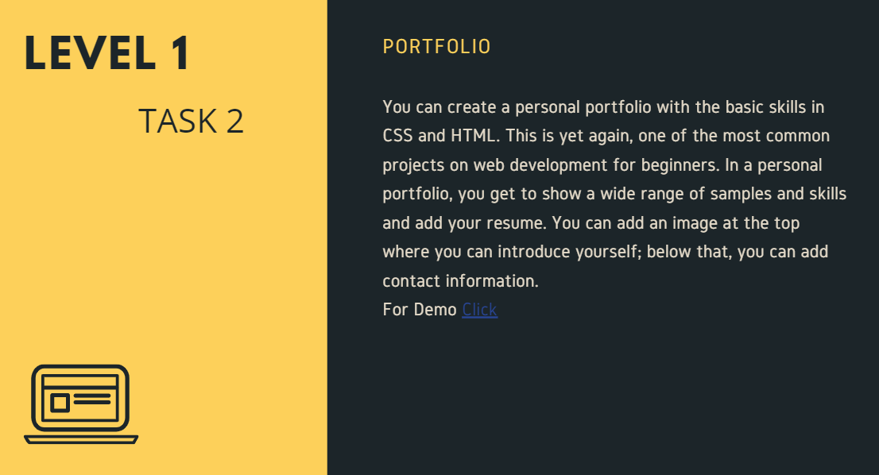
OASIS INFOBYTE
WEB DEVELOPMENT AND DESIGNING INTERN

